Slide 1
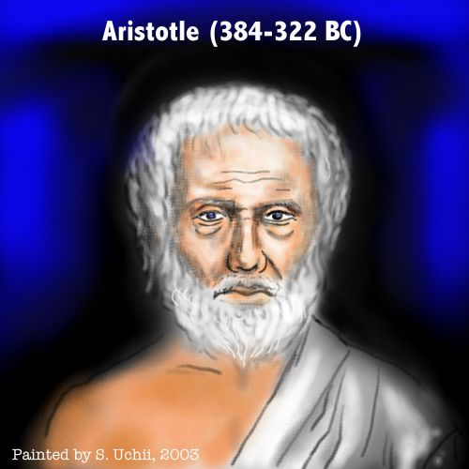
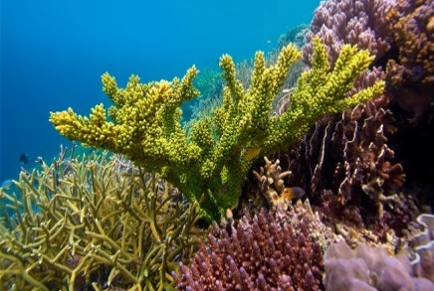
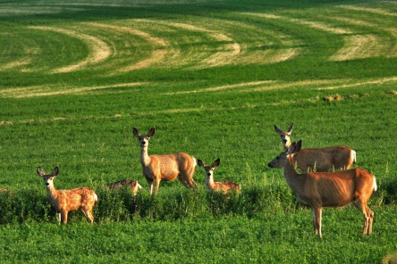
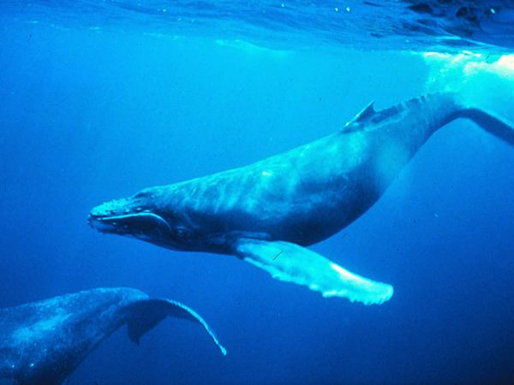
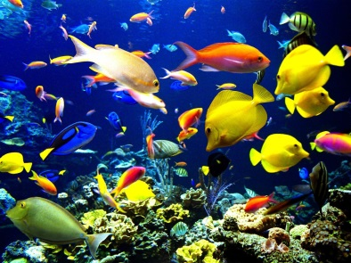
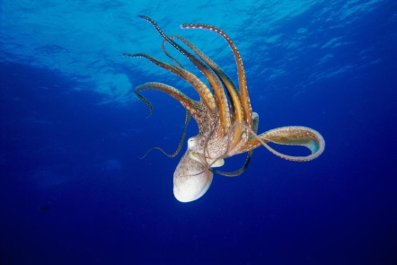
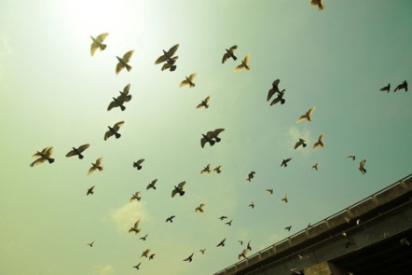
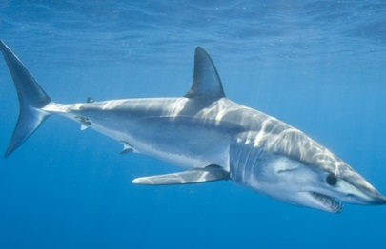
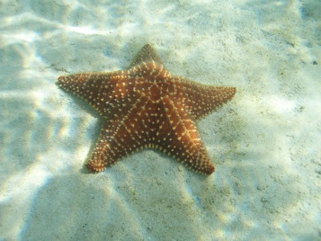
Basis of Classification?
First theory of classification was given by
Animals that live in the sea include
Classified animals according to whether they lived on
Land
Water
Air
Corals
Whale
Octopus
Aristotle
Shark
Starfish

Slide 2
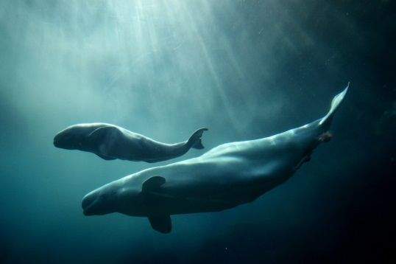
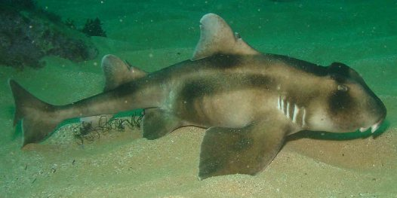
All these animals are very different from each other
Whales
Sharks
Whale gives birth to young ones
Shark lays eggs
They have only one common thing which is habitat
A place where an organisms lives
This is not a proper way to classify and group the organism

Slide 3


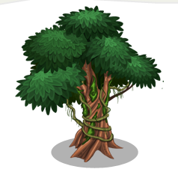
So, scientists thought to derive a better way of classification by deriving which characteristics to be used on the basis of classification.
Characteristic is a particular form or a particular function.
What is a characteristic?
For example, most of humans have five fingers on each hand is a characteristic
For example, Humans can run but banyan tree cannot is also a characteristic.

